Slide 1
COM 244
Object Oriented Programming
Some parts of those slides are adapted on course materials by Stuart Reges
http://www.cs.washington.edu/331/

Slide 2
Constructors
constructor: Generates new objects from a class
  public type(parameters) {
  declarations;
  }
  It is initialized from the new keyword in Java
  no return type is specified !!
  public class Point {
  private int xpos;
  private int ypos;
  public Point(int X, int Y) {
  xpos = X;// initialize
  ypos = Y; // initialize
  }

Slide 3
Multiple constructors
A class can have more than one constructor.
  Each one must have different parameters.
For instance : A Point constructor with no parameters that initializes the point to (100, 50).
  // Constructs a new point at (100, 50).
  public Point() {
  xpos = 100;
  ypos = 50;
  }
  or ???
  public Point(int x, int y, Color col) {
  ....
  }

Slide 4
This keyword
this : Refers to the implicit parameter inside your class.
  Refer to a field: this.field
  this.xpos;
  Call a method: this.method(parameters);

Slide 5
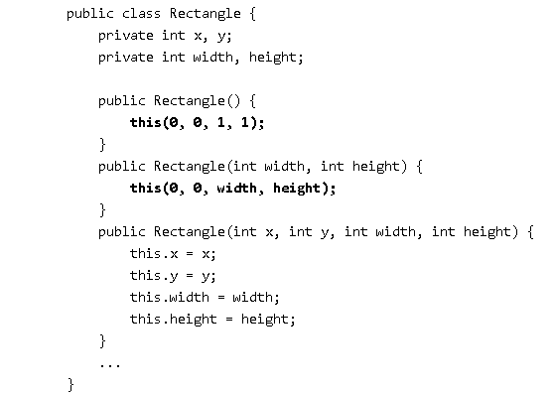
This keyword
Calling another constructor

Slide 6
Polymorphism
polymorphism: is the ability for the same code to be used with different types of objects and behave differently for each. The most common use of polymorphism in OOP occurs when a parent class reference is used to refer to a child class object.
  System.out.println can print any type of object.
    Each one displays in its own way on the console.

Slide 7
Coding with polymorphism
A variable of typeL can hold an object of any subclass of L .
  Mammals m = new Lion();
  You can call any methods from the Mammals class on m.
When a method is called on m, it behaves as a Lion.
  System.out.println(m.getWeight()); // 220 Kg
  System.out.println(m.getHeight()); // 140 cm.

Slide 8
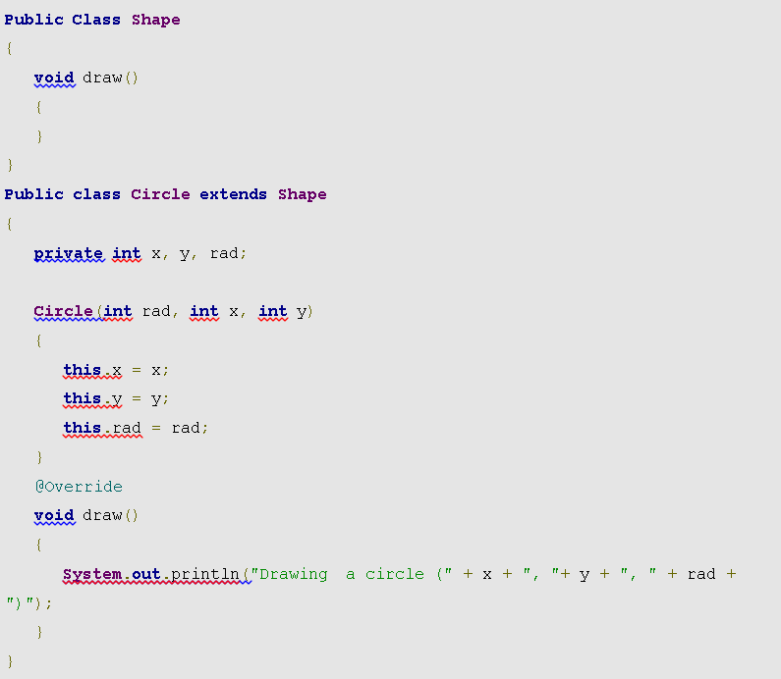
Polymorphism
Above example is adapted from https://www.javaworld.com/article/3033445/learn-java/java-101-polymorphism-in-java.html

Slide 9
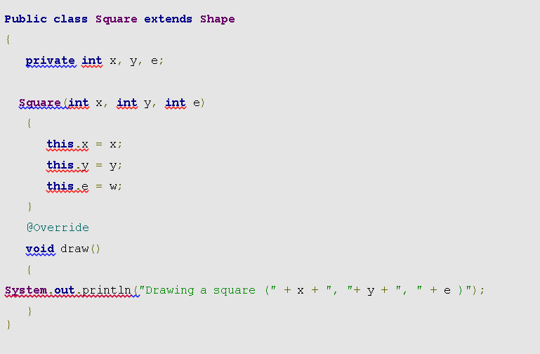
Polymorphism
Above example is adapted from https://www.javaworld.com/article/3033445/learn-java/java-101-polymorphism-in-java.html

Slide 10
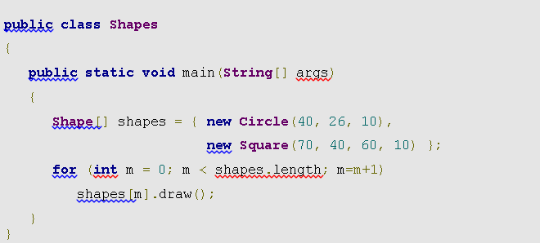
Upcasting and late binding in subtype polymorphism

Slide 11
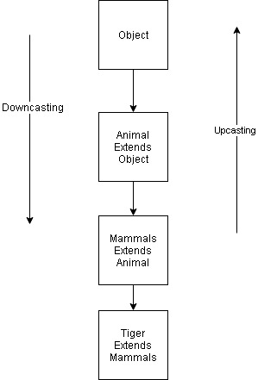
Casting references
Upcasting happens automatically , no need to do explicitly
Downcasting happens explicitly in Java

Slide 12
Casting references
A variable can only call that type's methods, not a subtype's.
  Mammals li = new Lion();
  int speed = li.getSpeed(); // ok; in Employee
  li.sue(); // compiler error
  The compiler's reasoning is, variable li is able to could store any kind of mammals , but not all kinds know how to sue .
To use Lion methods on li that we can type-cast it.
  Lion castedLi = (Lion) li;
  castedLi.sue(); // no error !!!!
  ((Lion) li).sue(); // short version

Slide 13
Casting references
Upcasting is casting to a supertype, while downcasting to a subtype. Upcasting is always allowed, but downvasting involves a type check and can throw a ClassCastException ….
Downcasting will be:
    Mammals mammal = new Tiger ();
    Tiger castedTiger = (Tiger) mammal
Otherwise,
Mammals mammal = new Mammals ();
Tiger notTiger = (Tiger) mammal
You will get a ClassCastException ….
However,
Mammals mammal = getMammal (); // Maybe a Tiger or Lion
if (animal instanceof Tiger){
Tiger castedTiger = (Tiger) mammal;
}

Slide 14
Casting example
public class Mammals {
public String getType()
{
System.out.println("Mammal");
return "Mammal";
}
}
public class Tiger extends Mammals {
public String getType()
{
System.out.println("Tiger");
return "Tiger";
}
}
public static void main(String[ ] args) {
Mammals m1 = new Mammals ();
Mammals m2 = new Tiger ();
}
Output:
Prints Mammal
Prints Tiger

Slide 15
Comparing objects
The == operator does not work well with objects.
  == compares references to objects, not their state.
  It only produces true when you compare an object to itself.
  Point x1 = new Point(25, 13);
  Point x2 = new Point(25, 13);
  Point x3 = x2;
  Point x4 = x1;
x4
...
x1
x | 25 | y | 13
x2
...
x | 25 | y | 13
x3

Slide 16
The equals method
The equals method compares the state of objects.
  if (m.equals(n)) {
  System.out.println("string m is equal to string n");
  }
But if you write a class, its equals method behaves like ==
  if (c1.equals(c2)) { // false
  System.out.println(«they are equal");
  }
  default behavior obtained from class Object.
  Java doesn't understand how to compare new classes by default.

Slide 17
The compareTo method
Java has compareTo method
  Defined as :
  public int compareTo(String variable
It compares strings on the basis of Unicode value of each character in the strings.
If first string is lexicographically greater than second string, it returns positive number and vica versa as follows
if m > n, it returns positive number
if n < m, it returns negative number
if m == n, it returns 0
Once the method is invoked as m.compareTo(n) will return:
  m value < 0 if m comes "before" n ,
  n value > 0 if m comes "after" n ,
  or 0 if m and n are considered as "equal" .

